Slide 1
ACS2913 Software Requirements Analysis and Design Instructor: Victor Balogun
Object-Oriented Design with Interaction Diagrams

Slide 2
Review Questions
What is a Sequence Diagram? 3
What are the components of a Sequence Diagram? 4, 5
5. List five elements included in a sequence diagram.
6. How does a sequence diagram differ from an SSD?
7. What is the difference between designing with CRC cards and designing with sequence diagrams?
8. Explain the syntax of a message on a sequence diagram.
What are the step-by-step process of OOD with Sequence Diagrams? 6
13. What assumptions do developers usually make while doing the initial use case realization?
What are the meaning of the following assumptions (i) perfect technology (ii) perfect memory (iii) perfect solution? 15
What is a Multilayer Sequence Diagram? 16
14. When doing multilayer design, what is the order in which layers should be designed? Why?
What are the two methods of instantiating a new object at the Data Layer? Describe the two methods 20 - 22
What are Class Packages? 25
What are Package Diagrams? 27
20. What is meant by a dependency relationship? How is it indicated on a drawing? 27
15. What is the “separation of responsibilities” principle?
What are the responsibilities of the individual 3 layers? 29 - 30

Slide 3
Sequence diagrams
UML sequence diagrams that model the flow of logic within a system in a visual manner
Sequence diagrams illustrate interactions in a kind of fence format, in which each new object is added to the right

Slide 4
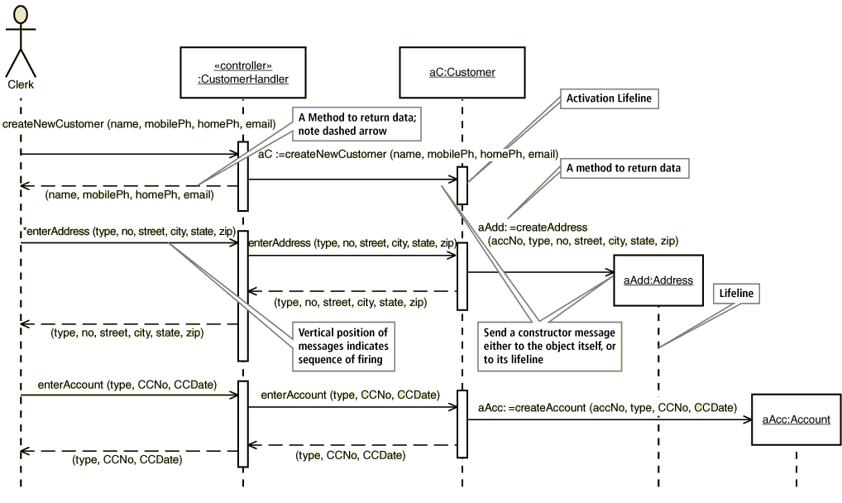

Slide 5
Understanding Sequence Diagrams
Lifeline
The dashed line under the object which serves as an origin point and a destination point for messages
Activation lifeline
The vertical box on a lifeline which indicates the time period when the object is executing based on the message
Messages have origins and destinations
May be on lifeline or on object box
Return values may be dashed message arrow, or on same message

Slide 6
OOD with Sequence Diagrams
Same process as with communication diagrams
Choose a use case
Input models – activity diagram, SSD, classes
Create first-cut DCD
Extend input messages
Add all required internal messages
Origin and destination objects
Elaborate each message
Add other layers as desired (view, data access)
Update DCD

Slide 7
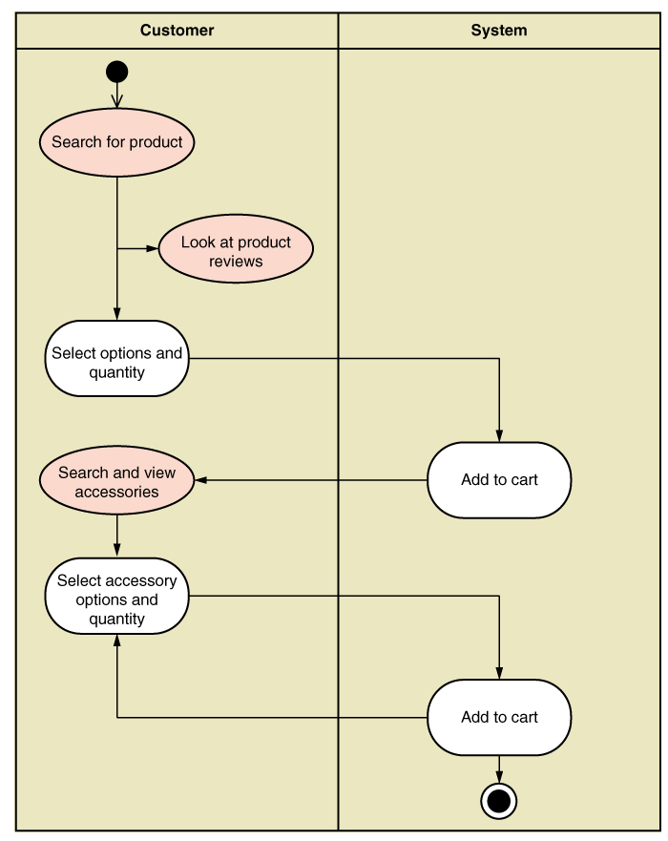
Example: Fill Shopping Cart
Input activity diagram
Note the activity flows that cross the system boundary

Slide 8
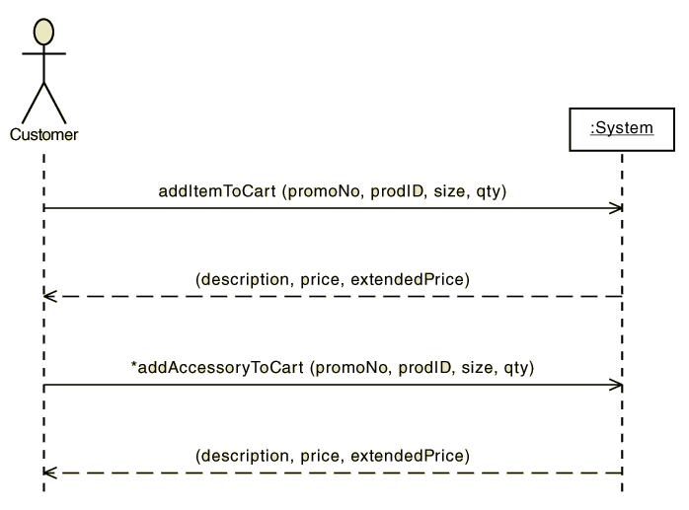
Example: Fill Shopping Cart
SSD
Note the input and return messages
Note the repeating message

Slide 9
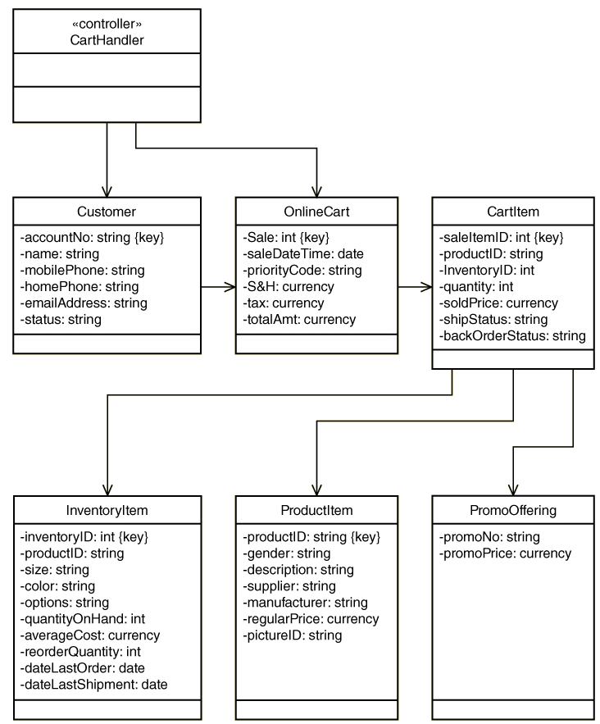
Example: Fill Shopping Cart
First-Cut DCD

Slide 10
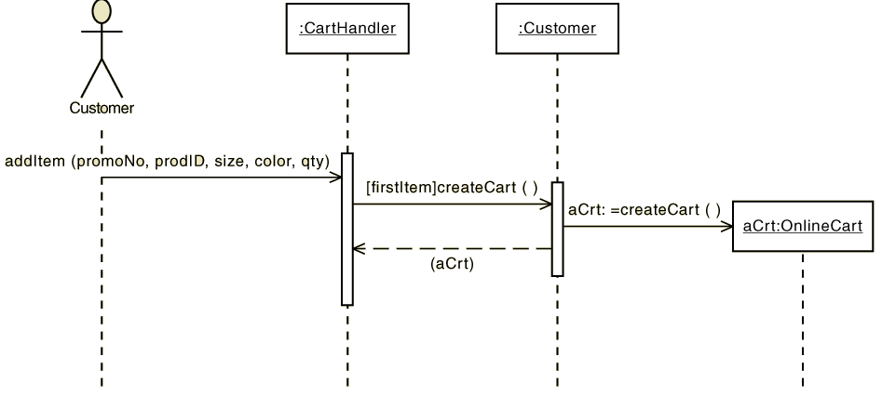
Example: Fill Shopping Cart
First step in addItem message. Create a cart if first item in the purchase
Note true/false test, two types of return values, named objects, activation lifelines, message origins and destinations

Slide 11
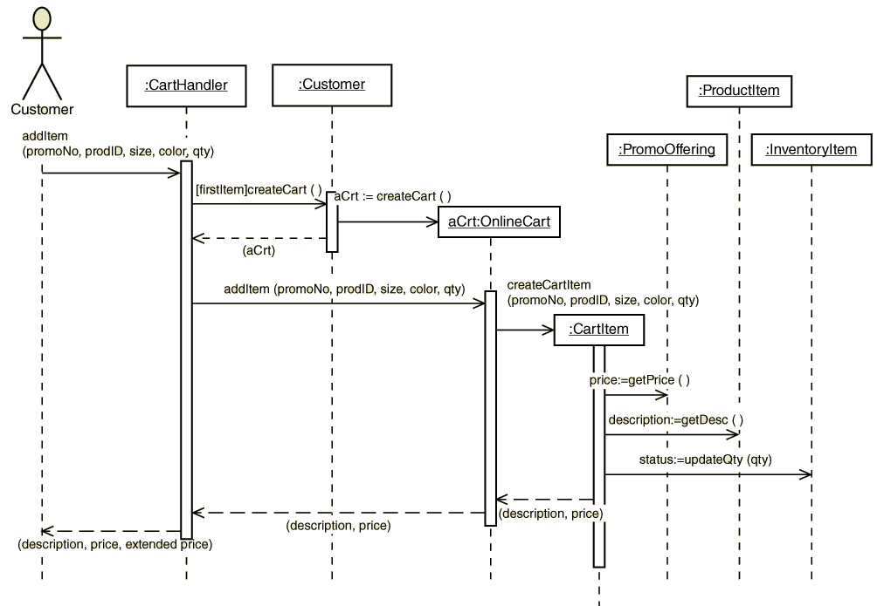
Example: Fill Shopping Cart
Completion of addItem message.

Slide 12
Example: Fill Shopping Cart
Note origin and destination objects and visibility
createCart () – cart handler knows if first item
aCrt:=createCart() – customer owns onlineCart
addItem() – forwarded message
createCartItem() – cartItem responsible for creating itself and getting values
getPrice() – just returns the price
getDescription() – just returns description
updateQty(qty) – initiates updates

Slide 13
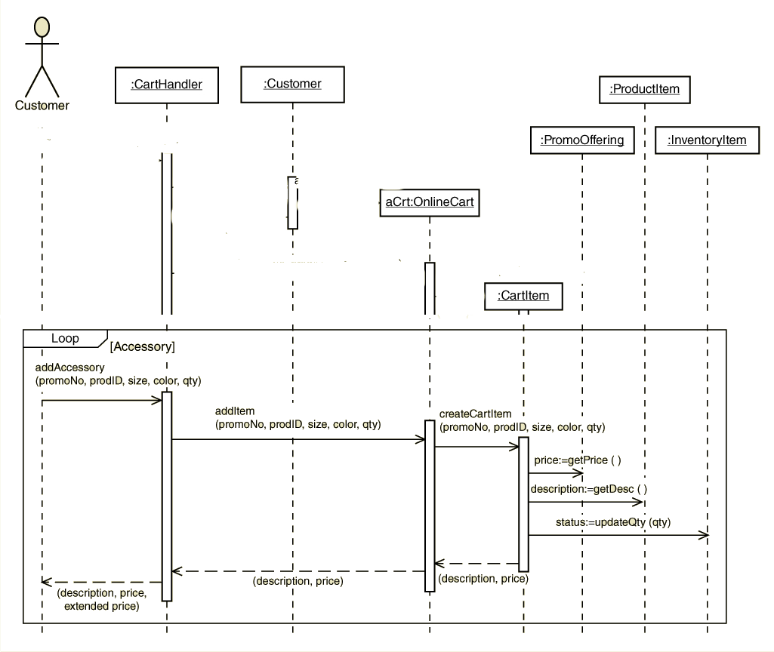
Example: Fill Shopping Cart
addAccesory message (with objects and lifelines)

Slide 14
Guidelines
From each input message
Determine all internal messages
Determine all objects (from classes) as origins or destinations
Flesh out each message with true/false conditions, parameters and returned values

Slide 15
Assumptions
Perfect technology assumption
No logon or other technical issues
Perfect memory assumption
No need to read or write data
Perfect solution assumption
No exception conditions, no error handling

Slide 16
Multilayer Sequence Diagrams
Add the view layer for input screens to handle input messages
Add data layer to read and write the data

Slide 17
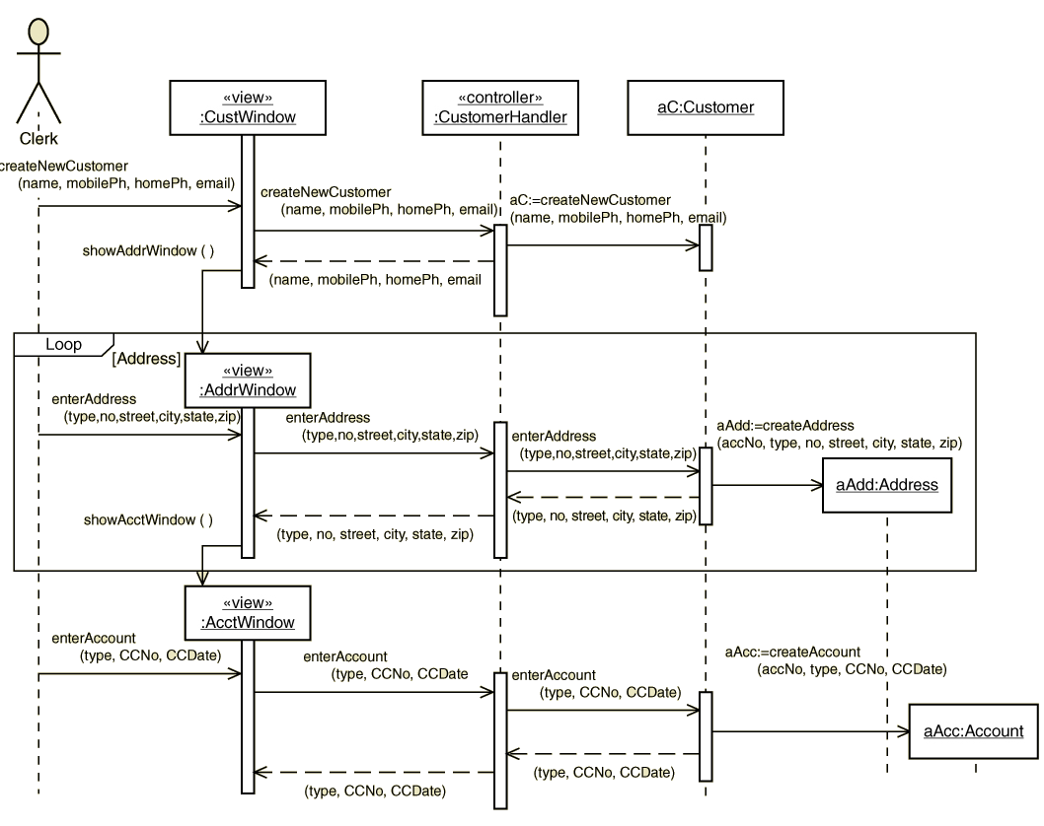
View Layer
Example: Add customer account use case

Slide 18
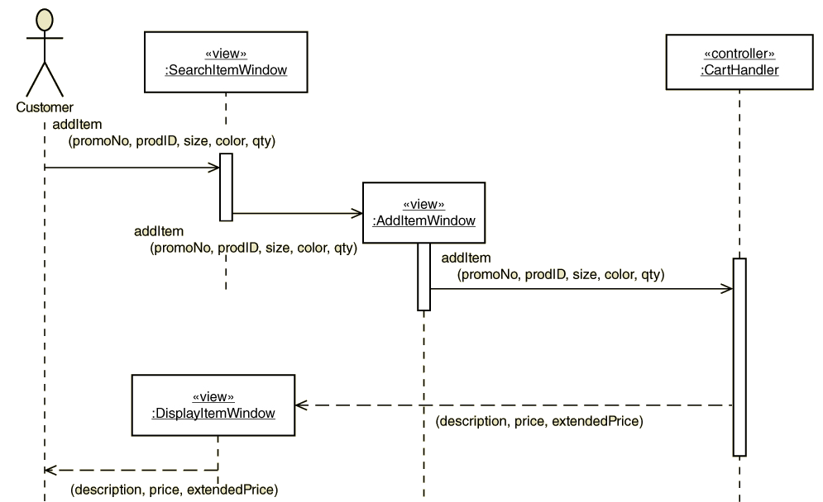
View Layer
Partial example: Fill shopping cart use case

Slide 19
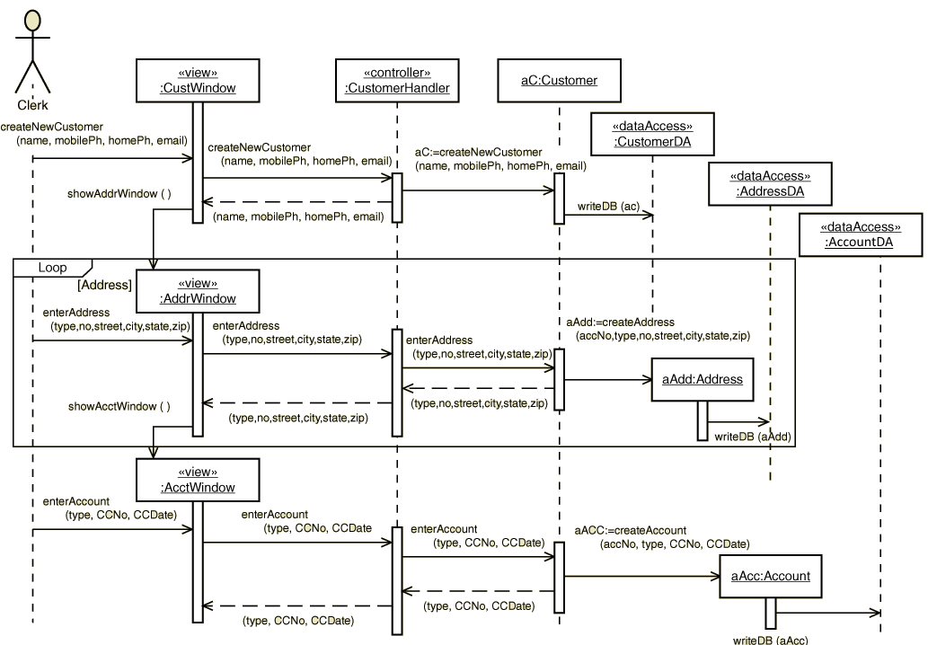
Data Layer
Data layer for reading or updating existing persistent objects

Slide 20
Data Layer
Data Access to instantiate a new object – Two methods
Instantiate the object in memory, the object invokes the data access to get any required persistent data
Send a message to the data access object, and it obtains the required persistent data and then instantiates the new object

Slide 21
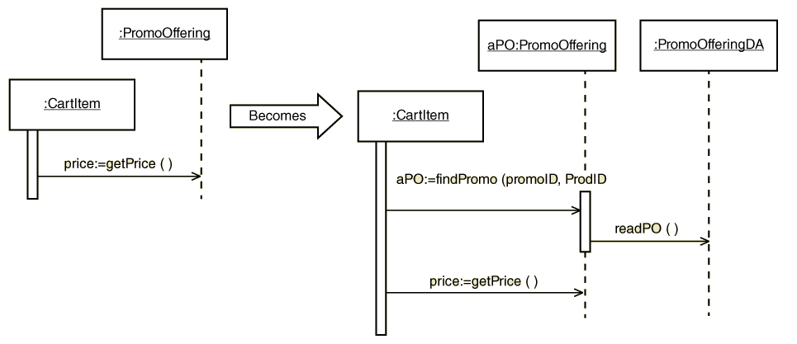
Instantiating a New Object
Method 1. The instantiated object gets the data

Slide 22
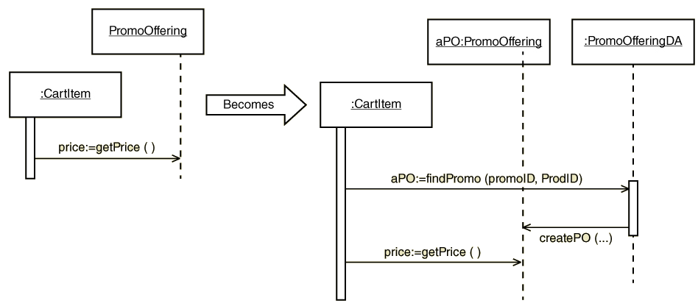
Instantiating a New Object
Method 2. The data access gets the data and instantiates the object

Slide 23
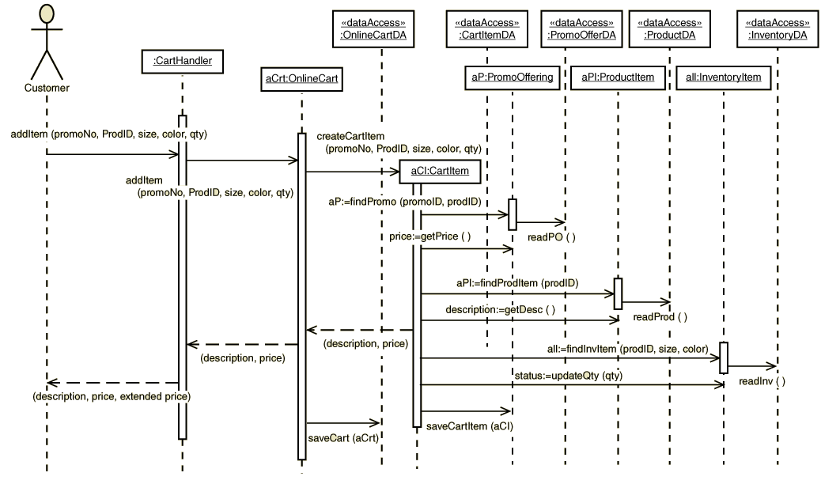
Partial Fill shopping cart with Data Access

Slide 24
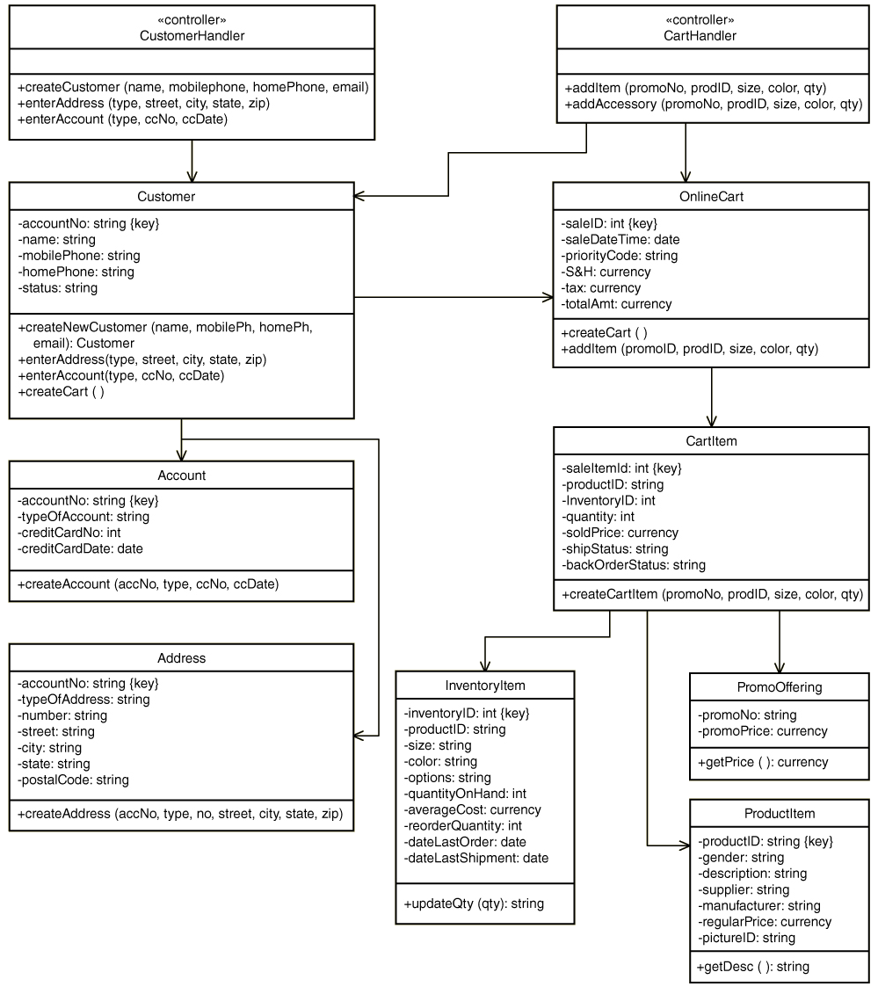
Updated DCD

Slide 25
Class packages
A package is a namespace that organizes a set of related classes and interfaces.
Conceptually you can think of packages as being similar to different folders on your computer.
You might keep HTML pages in one folder, images in another, and scripts or applications in yet another.
Because software written can be composed of hundreds or thousands of individual classes, it makes sense to keep things organized by placing related classes and interfaces into packages.
OO Programming languages such as Java, .net, etc, have pre-established Class packages in their APIs.

Slide 26
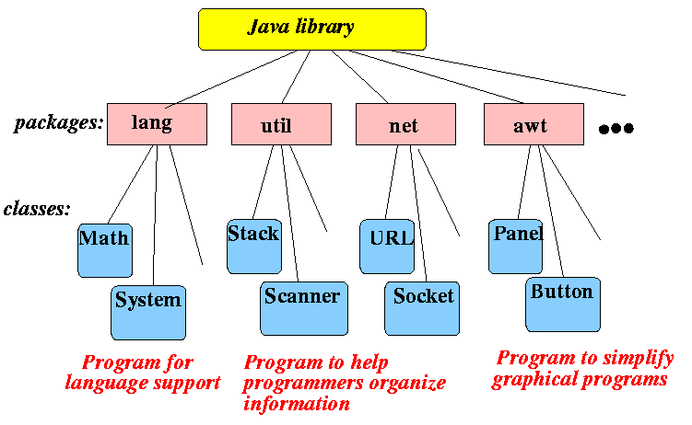
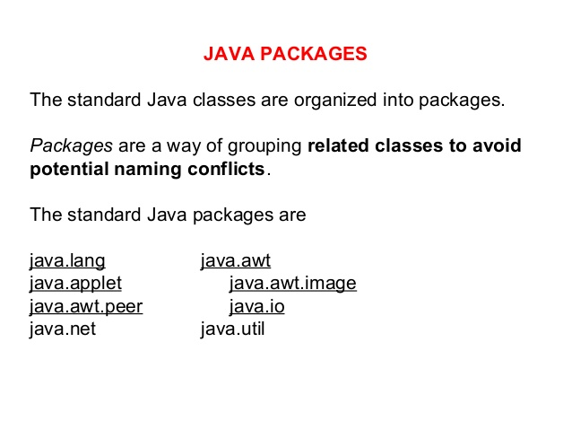

Slide 27
Package Diagrams
Can be used to define formal packages such as subsystems
Can be used informally to group classes together for understanding
Dependency relationship
A relationship between packages or classes within a package in which a change of the independent component may require a change in the dependent component. Indicated by dashed line. Read in the direction of the arrow, i.e. A→B is A depends on B.

Slide 28
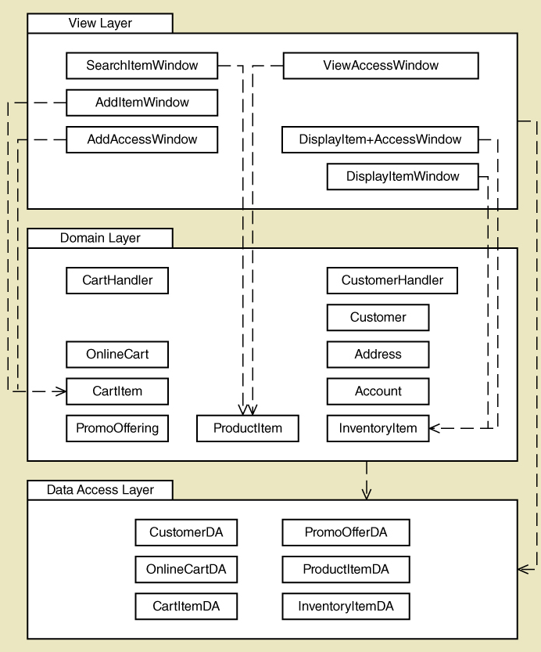
Package Diagram
Three-layer package diagram of classes
Dependencies
View layer depends on Data Access layer
SearchItemWindow depends on ProductItem
etc.

Slide 29
Implementation Issues - Three Layer Design
View Layer Class Responsibilities
Display electronic forms and reports.
Capture such input events as clicks, rollovers, and key entries.
Display data fields.
Accept input data.
Edit and validate input data.
Forward input data to the domain layer classes.
Start and shut down the system.

Slide 30
Implementation Issues - Three Layer Design
Domain Layer Class Responsibilities
Create problem domain (persistent) classes.
Process all business rules with appropriate logic.
Prepare persistent classes for storage to the database.
Data Access Layer Class Responsibilities
Establish and maintain connections to the database.
Contain all SQL statements.
Process result sets (the results of SQL executions) into appropriate domain objects.
Disconnect gracefully from the database.

Slide 31
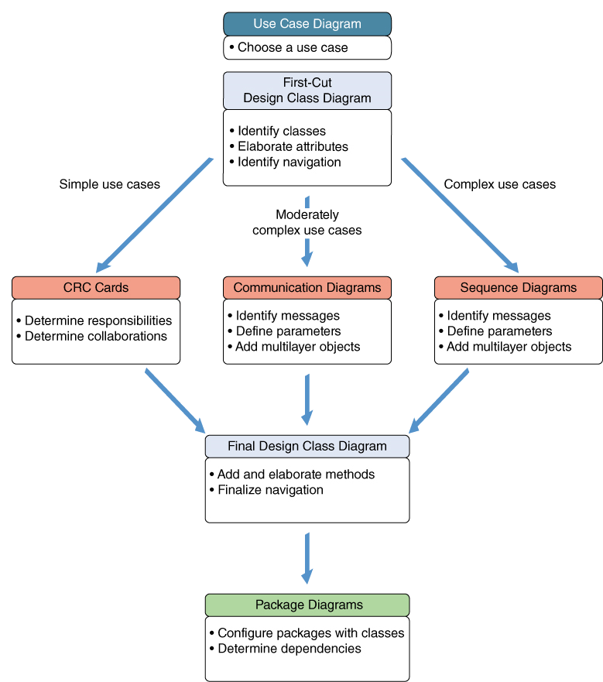
OOD - review
First-cut DCD
Extend use case with Communication Diagram
Final DCD
Package diagram

Slide 32
Summary
This chapter went into more detail about use case realization and three layer design to extend the design techniques from last chapter
Three layer design is an architectural design pattern, part of the movement toward the use of design principles and patterns.
Use case realization is the design of a use case, done with a design class diagram and interaction diagrams. Using interaction diagrams allows greater depth and precision than using CRC cards.
Use case realization proceeds use case by use case (use case driven) and then for each use case, it proceeds layer by layer

Slide 33
Summary (continued)
Starting with the business logic/domain layer, domain classes are selected and an initial design class diagram is drawn.
The systems sequence diagram (SSD) from analysis is expanded by adding a use case controller and then the domain classes for the use case.
Messages and returns are added to the interaction diagram as responsibilities are assigned to each class.
The design class diagram is then updated by adding methods to the classes based on messages they receive and by updating navigation visibility.
Simple use case might be left with two layers if the domain classes are responsible for database access. More complex systems add a data access layer as a third layer to handle database access

